Slide 1

Class : 5
SAS Tutorial
Presented By : Shashi Kumar

Slide 2
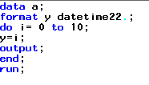
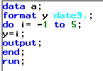
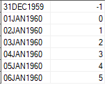
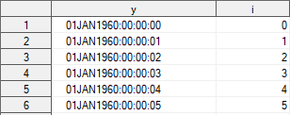
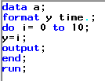
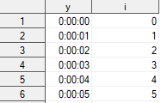
Working with Date/Time/Date Time :
SAS Date value
is a value that represents the number of days between January 1, 1960, and a specified date. SAS can perform calculations on dates ranging from A.D. 1582 to A.D. 19,900. Dates before January 1, 1960, are negative numbers; dates after January 1, 1960, are positive numbers.
SAS time value
is a value representing the number of seconds since midnight of the current day. SAS time values are between 0 and 86400
SAS datetime value
is a value representing the number of seconds between January 1, 1960, and an hour/minute/second within a specified date.

Slide 3
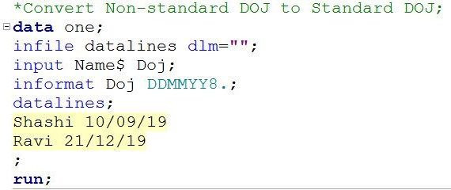
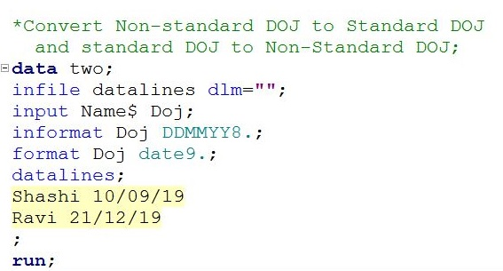


Formats Date/Time/Date Time :
Format : Which is used to convert standard data to non standard data.
Informant : Which is used to convert Non Standard data into standard data.
10/09/08 : Non-Standard :::: Informant ::::::MMDDYY8.
$40,000 : Non-Standard :::: Informant ::::::Dollar7.
74,000 : Non-Standard :::: Informant ::::::Comma6.
34555 : Standard ::::::::::: Format :::::::: ?? (Comma6., MMDDYY8.,date9……)
Format variable name <$> formatW.d;
W : Total Width
d : Number of decimal place
$ : It indicate Character format
i.e, Format Doj date9.;
(Format either SAS built or User define format (Proc format))

Slide 4
Formats Date/Time/Date Time :
Input | Format |  | Output
1 | Date7. | 1 | 01JAN60
1 | Date9. | 1 | 01JAN1960
1 | DDMMYY10. | 1 | 01/01/1960
1 | DDMMYY. | 18703 | 17/03/11
1 | DDMMYY10. | 18703 | 17/03/2011
1 | DDMMYYB. | 18703 | 17 03 11
1 | DDMMYYB10. | 18703 | 17 03 2011
There are various date / Time / Date time formats
as per your need your choose your format.
Especially in transections data datetime format is datetime22.
Format | Input | Output
HHMM. | 53132 | 14:46
HOUR. | 53132 | 15
MMSS. | 53132 | 885
TIME. | 53132 | 14:45:32
TOD. | 53132 | 14:45:32

Slide 5
Formats Date/Time/Date Time :
Today :- Return a current date from a SAS date value.
Day :- Extract the day of the month from a SAS date and returns a number from 1-31.
Weekdays :- Returns the day of the week from SAS date and return a number from 1 to 7.
(Sunday =1; Monday=2;Tuesday=3;Wednesday=4;Thrusday=5;Friday=6;Saturday=7)
Month :- Extract the month from the SAS date and return a number from 1 to 12.
(January =1;February=2;March=3;April=4………December=12)
Year :- Extract the year from the SAS date and returns 4 digit of years.
Qtr :- Extract the quarter from the SAS date and returns number from 1-4.
(Jan- March = 1;Apr-June=2;July-Sep=3;October-December=4)
MDY :- Return a SAS date value from numeric month, day and year value.
Function | Input | Output
Today | Current System Date | 21534
Day | 13FEB2019 | 13
Weekday | 13FEB2019 | 4
Month | 13FEB2019 | 2
Qtr | 13FEB2019 | 1
Year | 13FEB2019 | 2019
MDY | (02,13,2019) *Arg should be numeric | 21534 (Days From 1 Jan 1960)

Slide 6
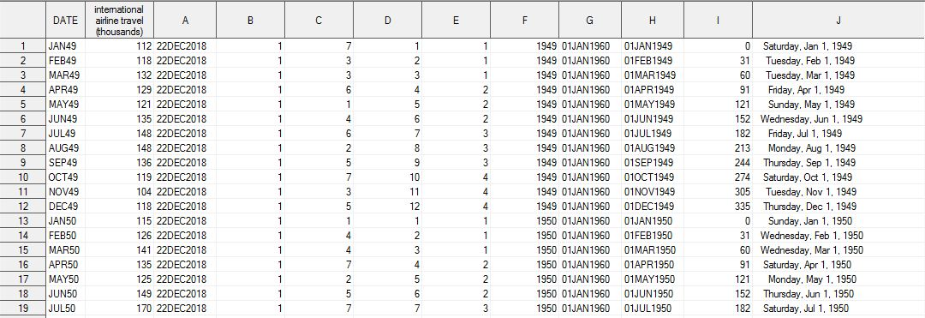
Formats Date/Time/Date Time :
data test;
set sashelp.air;
A=today();
B=day(date);
C=weekday(date);
D=month(date);
E=qtr(date);
F=year(date);
G=MDY(1,1,1960);
H=MDY(D,B,F);
I=MDY(month(date),1,year('08JAN1960'd));
J=date;
format A G H date9. J weekdate24.;
run;

Slide 7
Character and Numeric Functions:
Trim(variable) *Remove trailing Blank | Cmiss(variable/vector) *count of Missing across row both char & num. Variable.
Strip(variable) *Remove Leading and Trailing Blank | n() * count non missing values
Left(variable) * Left Align a Character String | Scan(String,nth word,delimeter) * Return nth word of the character value
Right(variable) * Right Align a Character String | Find(string,substring,modifier,start position)* It search a target string to specified substring and return numeric value.
Lowcase(variable) * Convert in Low Case | Cat(String1,String2,…Stringn) *Doesnot renove leading and trailing blank before concatenate
Upcase(variable) * Convert in Up Case | Catt(String1,String2,…Stringn) * Remove trailing blank before concatenate
Propcase(variable) * Convert in 1st character in up case and reaming low case | Cats(String1,String2,…Stringn) * Remove leading blank before concatenate
Length(variable) * Return total number of column width | Catx(delimeter,String1,String2,…Stringn) * Remove leading and trailing blank and add delimiter between string
Char(variable,pos) *Return a single character from specified position in a character String | Tranwrd (Source,target,replacement) *Search and replace from character string
Int(variable) | Input(Source,Informat) * Convert to numeric
Ceil(variable) | Put(Source,format) * Round and convert to character
Floor(variable) | Substr(String,Start position,Length) * Extract character from string
Round(variable) | Compress(Source,Character,modifier) *Removes the characters listed in the character argument from the source.
Nmiss(variable/vector) *count of Missing across row both numeric variable | Compbl(String) * Remove multiple blank from a String by translating each occurrence of two or more conjugative blank into single blank.

Slide 8
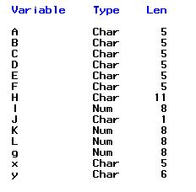
Character and Numeric Functions:
data test;
x=' Ram ';
y=' Sita ';
A=trim(x);
B=strip(x);
C=left(x);
D=right(x);
E=upcase(x);
F=lowcase(x);
g=length(x);
H=x!!y;
I=length(H);
J=char(x,2);
K=length(x);
L=length(D);
run;
proc contents data=test; run;

Slide 9
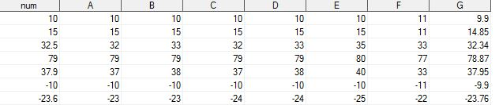
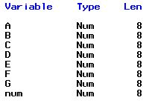
Character and Numeric Functions:
data test2;
infile datalines;
input num;
A=int(num);
B=ceil(num);
C=Floor(num);
D=round(num);
E=round(num,5);
F=round(num,11);
G=round(num,.33);
datalines;
10
15
32.5
79
37.9
-10
-23.6
;
run;
If A is +ve then int(num)=floor(num)
If A is -ve then int(num)=Ceil(num)
Round: convert to nearest integer with multiple of 2nd argument.

Slide 10
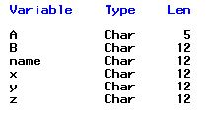
Character and Numeric Functions:
data test3;
name='Shashi Kumar';
x=substr(name,1,2);
y=substr(name,3,2);
z=substr(name,1,7);
A=substr('Mohan',3,1);
B=substr(upcase(name),3,4);
run;

Slide 11

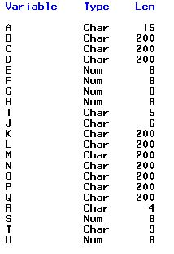
Character and Numeric Functions:
data test4;
A='Today is FRIDAY';
B=scan(A,2);
C=scan(A,1,'a');
D=scan(A,-1);
E=find(A,'a');
F=find(A,'A');
G=find(A,'a',7);
H=find(A,'a','i',7);
I=' Ram ';
J=' Sita ';
K=cat(I,J,I);
L=catt(I,J,I);
M=cats(I,J,I);
N=catx('/',I,J,I);
O=catx('0',I,J,I);
P=tranwrd(N,'/','*');
Q=tranwrd(N,'Ram','Sita');
R='$500';
S=0;
T=put(S,date9.);
U=input(R,dollar4.);
run;

Slide 12
Character and Numeric Functions:
*%%%%%%%%%%%%%%%%%%%% compress %%%%%%%%%%%%%;
data test8;
string='StudySAS Blog! 17752 ' ;
string1=compress(string,'') ; *Compress spaces. This is default;
string2=compress(string,'','ak'); *Compress alphabetic chars(1,2etc);
string3=compress(string,'','d') ; *Compress numerical values;
string4=compress(string,'','l'); *Compress lowercase characters;
string5=compress(string,'','u'); *Compress uppercase characters;
string6=compress(string,'S','k'); *Keeps only specified characters;
string7=compress(string,'!.','P'); *Compress Punctuations only;
string8=compress(string,'s','i'); *upper/lower case specified characters;
string9=compress(string,'','a'); *Compress all upper\lower case characters ;
string10=compress(string,'','s') ; * Compress or delete spaces;
string11=compress(string,'','kd') ; *Compress alphabets (Keeps only digits);
run ;

Slide 13
Thank You …

